Slide 1
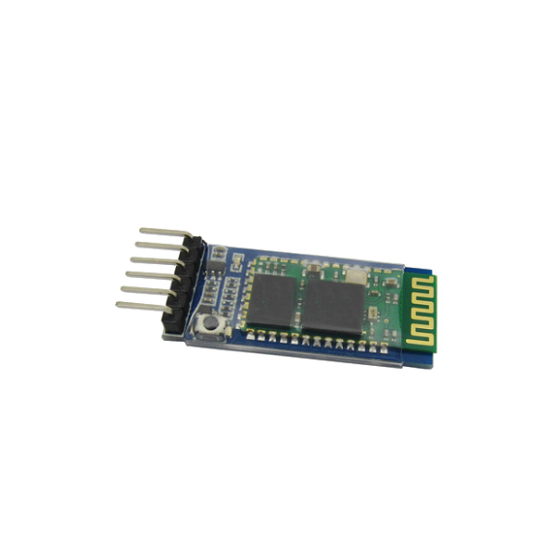
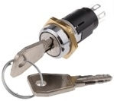

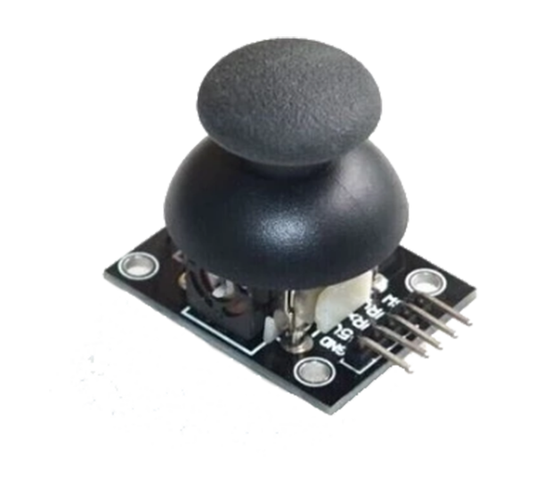
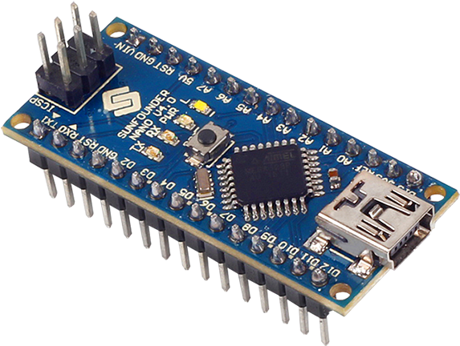

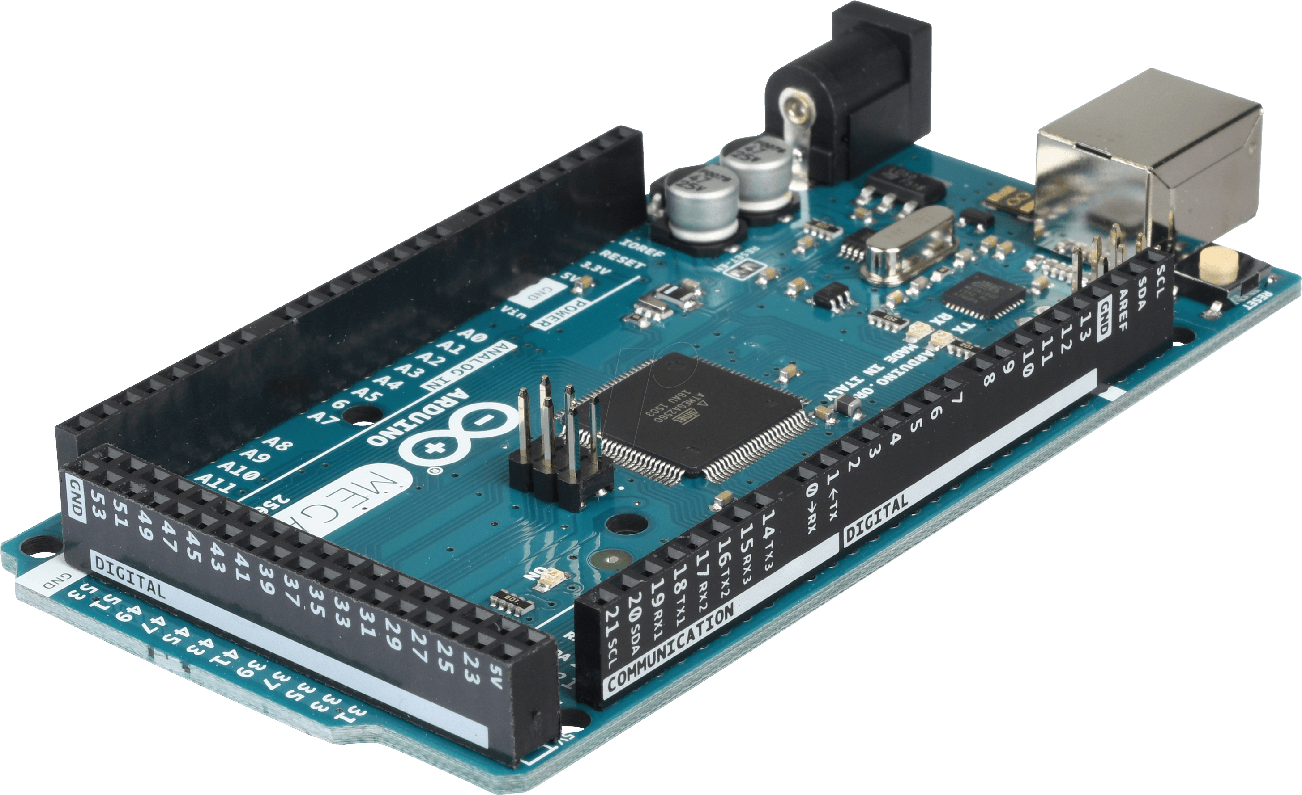
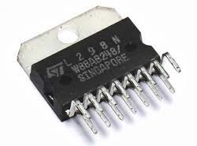
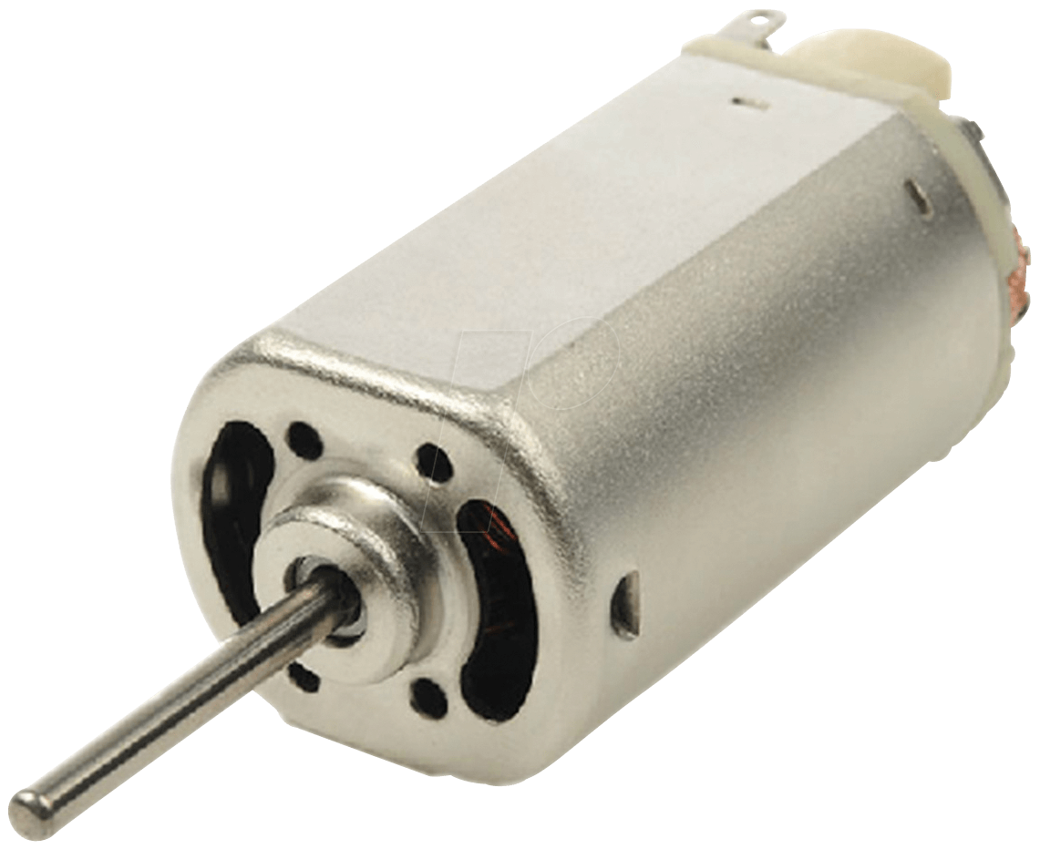
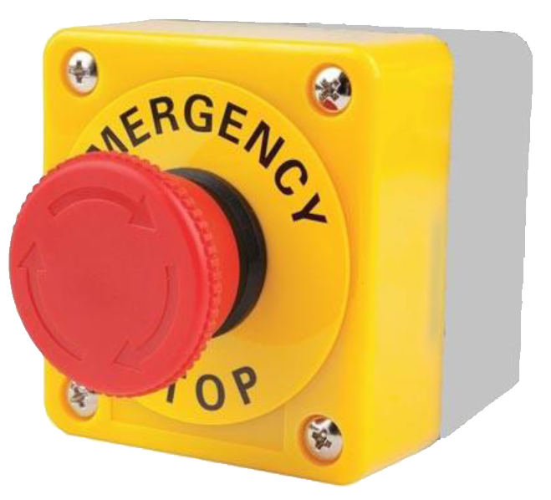
Remote Control PCB
4x 18650 Batteries
9V
Battery
Key Switch
HC05
14.8V
XL4015 Buck Boost Converter Module
D24V10F5 5V Regulator Module
Joystick
Arduino Nano
7.5V
5V
With User
Power Distribution Board
5V
7.5V
5V
5V
Motor Controller PCB
HC05
Arduino Mega
Low Level Controller (LLC)
Arduino Nano
L298N Motor Driver IC
DC Gear Motor
On Rover
E-stop switch

